Slide 1
NEWS WEBSITE
Presented
by
Gourav Rana(2210990330)
Dhruv Walia(2210990280)
Dipanshu Saini(2210990288)
Divyan Rai(2210990295)
Name of the Supervisor(s)
Mr. Vikas Patel
Ms. Parul Gehlot
Chitkara University, Punjab

Slide 2
Introduction
Welcome to the in-depth exploration of HTML,CSS and JS integration for a dynamic news website .This presentation will cover the essential techniques and best practices for creating a compelling online news platform

Slide 3
Motivation of Research
The motivation behind the research for our news website, developed using HTML, CSS, and JS, is driven by a commitment to excellence, user satisfaction, and staying ahead in the dynamic field of digital journalism.
We ensure that the news presented on the website is accurate, unbiased, and from reliable sources.

Slide 4
HTML STRUCTURE
HTML (Hyper Text Markup Language) plays a fundamental and crucial role in the structure and presentation of content on our news website.
Understanding the fundamental structure of html is crucial for organizing and presenting news content effectively. Sematic Html elements play a key role in enhancing accessibility and search engine optimization
[

Slide 5
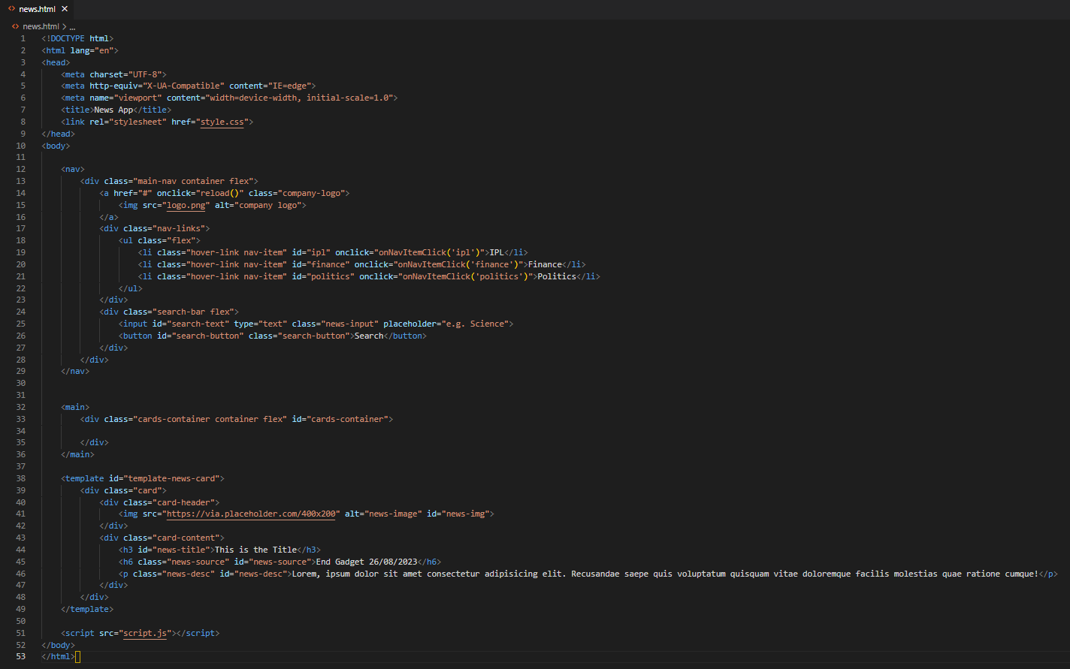
Code Snapshots
Code Snippet for HTML

Slide 6
CSS Styling
We utilized CSS to create visually appealing layouts and designs that capture the attention of the readers. It helped us to apply responsive design principles and optimized styles for various devices

Slide 7
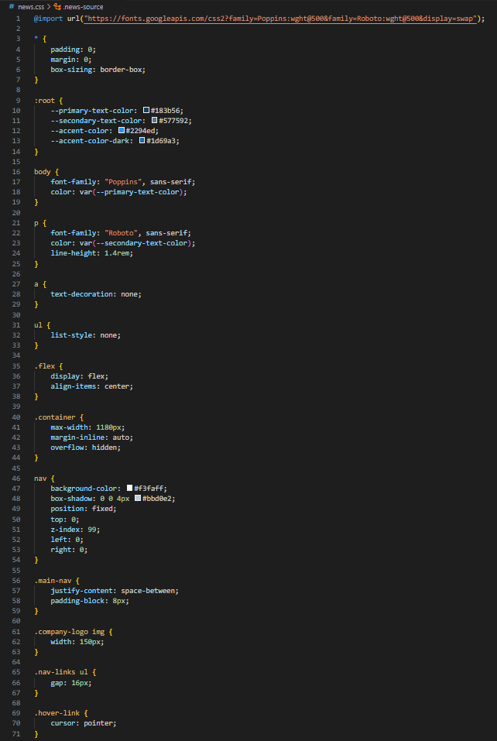
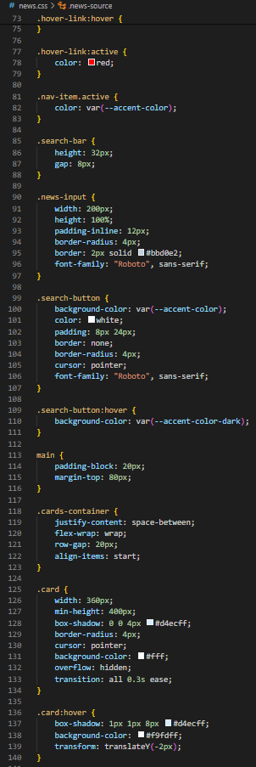
Code Snapshots
Code Snippet for CSS

Slide 8
JavaScript Integration
We enhanced our user interaction and dynamic content delivery with JavaScript.
With the help of JavaScript we implemented features such as live updates, interactive elements, and seamless navigation.

Slide 9
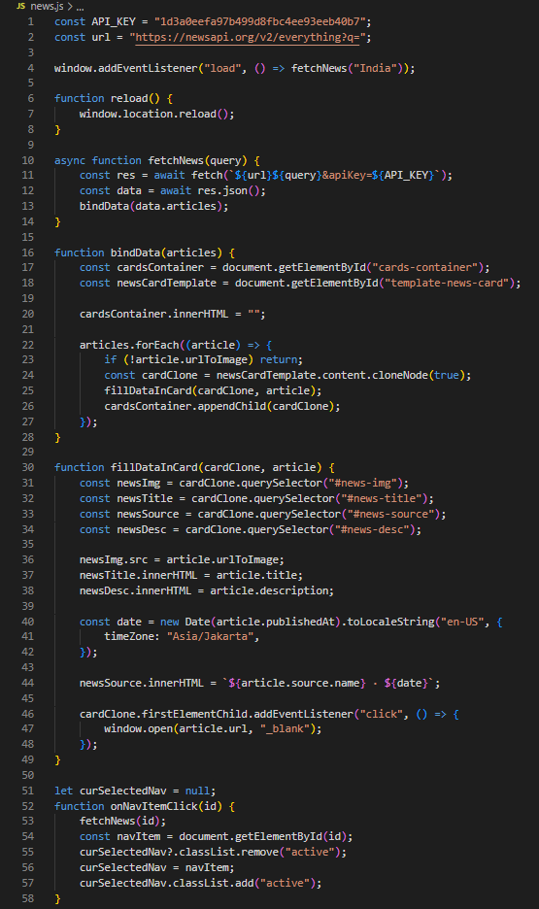
Code Snapshots
Code Snippet for JS

Slide 10
Conclusion
"In conclusion, the creation of our news website marks a significant milestone in the digital realm.
Through the seamless integration of HTML, CSS, and JavaScript, we've not only built a visually appealing platform but also a dynamic and user-friendly experience for our audience.
The power of technology has enabled us to deliver news in an engaging and accessible manner.

Slide 11
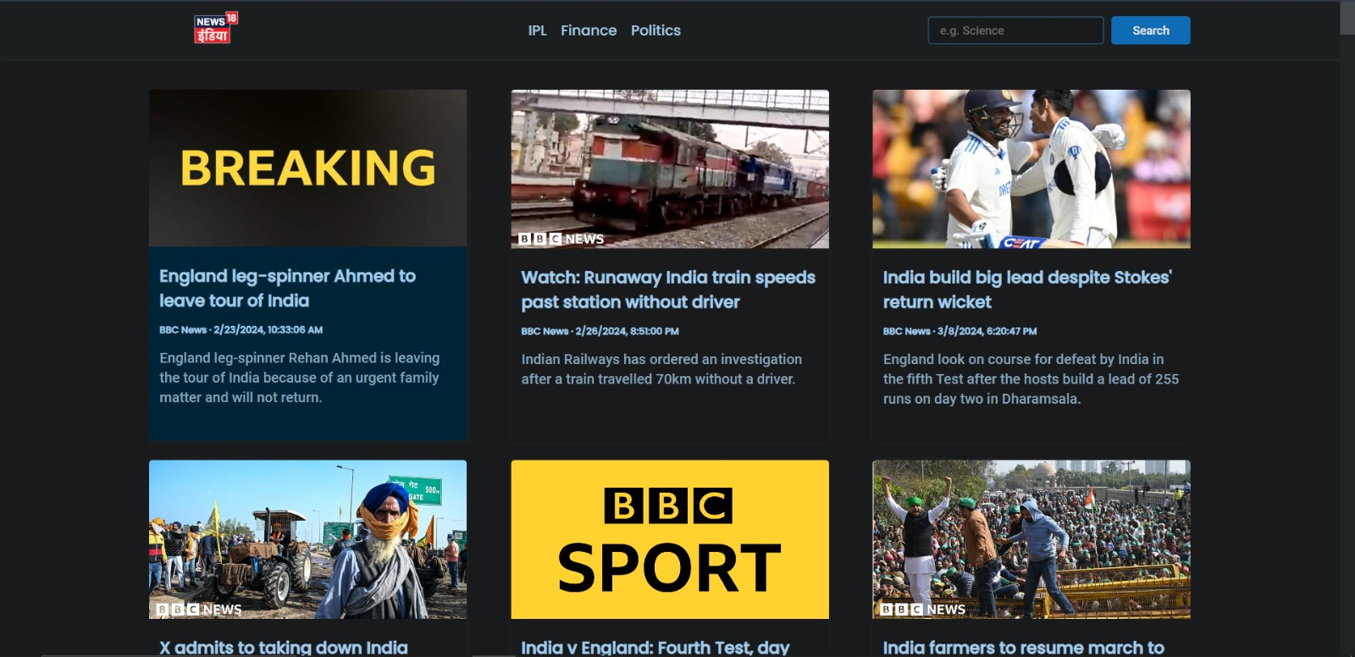
Output

Slide 12
References
Key references for our study:
W3Schools:
https://www.w3schools.com/html/default.asp
https://www.w3schools.com/css/default.asp
https://www.w3schools.com/js/default.asp
JavaScript.info:
The Modern JavaScript Tutorial
YouTube tutorials:
ez snippet , Code with Harry ,Code Shuttle, Apna College

Slide 13
Questions???
Thanks!
Do you have any questions?
gourav330.be22@chitkara.edu.in
dhruv330.be22@chitkara.edu.in
dipanshu288.be22@chitkara.edu.in
divyan295.be22@chitkara.edu.in

